Slide 1
Chapter 9
Conceptual Knowledge

Slide 2
Conceptual Knowledge
Conceptual knowledge: enables us to recognize objects and events and to make inferences about their properties
Concept: mental representation used for a variety of cognitive functions
Categorization: the process by which things are placed into groups called categories
  Categories are all possible examples of a particular concept

Slide 3
Why Categories Are Useful (1 of 2)
Help to understand individual cases not previously encountered
“Pointers to knowledge”
  Provide a wealth of general information about an item
  Allow us to identify the special characteristics of a particular item

Slide 4
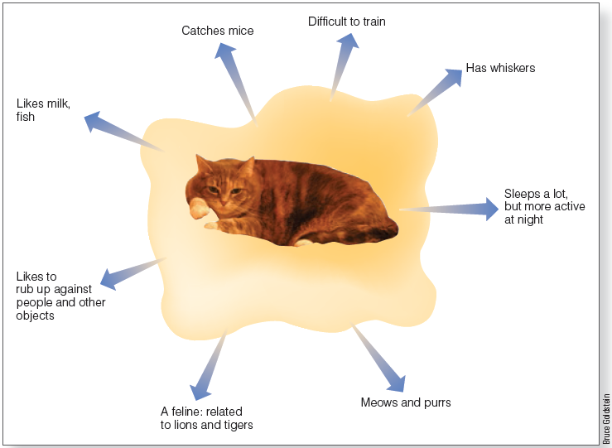
Why Categories Are Useful (2 of 2)
Notes:
Figure 9.1 Knowing that something is in a category provides a great deal of information about it.

Slide 5
Definitional Approach to Categorization (1 of 2)
Determine category membership based on whether object meets the definition of the category
Does not work well
Not all members of everyday categories have the same defining features
Family resemblance
  Items in a category resemble one another in a number of ways

Slide 6
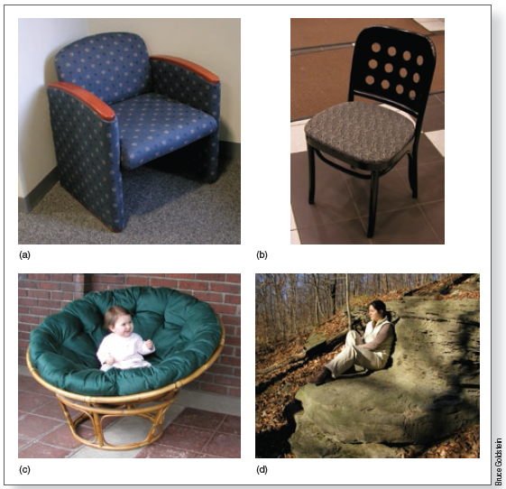
Definitional Approach to Categorization (2 of 2)
Notes:
Figure 9.2 Different objects, all possible “chairs”

Slide 7
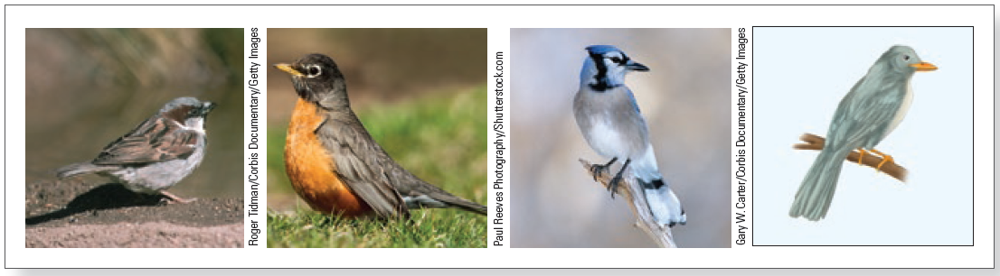
The Prototype Approach (1 of 5)
Prototype: an average representation of the “typical” member of a category
Characteristic features that describe what members of that concept are like
An average of category members encountered in the past
Notes:
Figure 9.3 Three real birds—a sparrow, a robin, and a blue jay—and a “prototype” bird that is the average representation of the category “birds.”

Slide 8
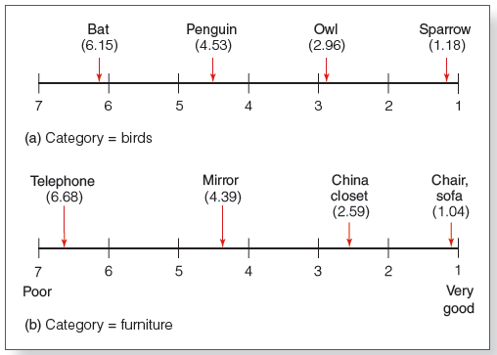
The Prototype Approach (2 of 5)
Notes:
Figure 9.4 Results of Rosch’s (1975a) experiment, in which participants judged objects on a scale of 1 (good example of a category) to 7 (poor example): (a) ratings for birds; (b) ratings for furniture.

Slide 9
The Prototype Approach (3 of 5)
High prototypicality: a category member closely resembles the category prototype
  “Typical” member
  For category “bird” = robin
Low prototypicality: a category member does not closely resemble the category prototype
  For category “bird” = penguin

Slide 10
The Prototype Approach (4 of 5)
Strong positive relationship between prototypicality and family resemblance
Items in a category that have a large amount of overlap have high family resemblance
Low overlap = low family resemblance

Slide 11
The Prototype Approach (5 of 5)
Typicality effect: prototypical objects are processed preferentially
  Smith and coworkers (1974)
    Highly prototypical objects judged more rapidly
  Rosch (1975b)
    Prototypical objects are named more rapidly
    Prototypical category members are more affected by a priming stimulus
  Hearing “green” primes a highly prototypical “green”

Slide 12
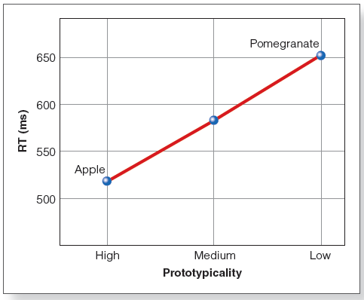
Prototype Approach: Smith’s Sentence Verification
Notes:
Figure 9.5 Results of E. E. Smith et al.’s (1974) sentence verification experiment. Reaction time (RT) was faster for objects rated higher in prototypicality.

Slide 13
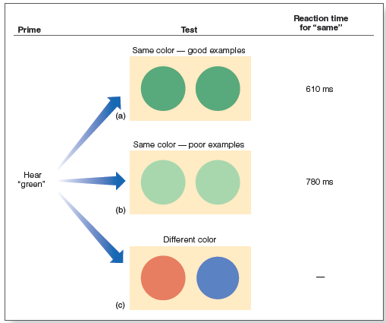
Prototype Approach: Rosch’s Priming (1 of 2)
Notes:
Figure 9.6 Procedure for Rosch’s (1975b) priming experiment. Results for the conditions when the test colors were the same are shown on the right. (a) The person’s “green” prototype matches the good green but (b) is a poor match for the light green; (c) shows the condition in which colors were different.

Slide 14
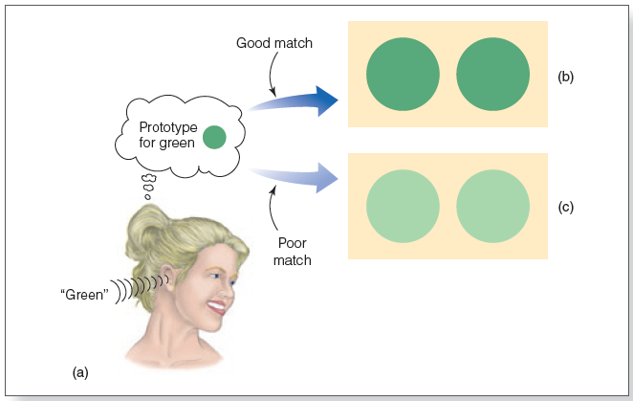
Prototype Approach: Rosch’s Priming (2 of 2)
Notes:
Figure 9.7 How Rosch explains the finding that priming resulted in faster “same” judgments for prototypical colors than for nonprototypical colors.

Slide 15
The Exemplar Approach (1 of 3)
Concept is represented by multiple examples (rather than a single prototype)
Examples are actual category members (not abstract averages)
To categorize, compare the new item to stored examples

Slide 16
The Exemplar Approach (2 of 3)
Similarity to prototype view:
  Representing a category is not defining it
  Difference from prototype view:
  Representation is not abstract
  Descriptions of specific examples
  The more similar a specific exemplar is to a known category member, the faster it will be categorized (family resemblance effect)

Slide 17
The Exemplar Approach (3 of 3)
Explains typicality effect
Easily takes into account atypical cases
Easily deals with variable categories

Slide 18
Prototypes or Exemplars?
May use both
Exemplars may work best for small categories
Prototypes may work best for larger categories

Slide 19
Hierarchical Organization (1 of 2)
To fully understand how people categorize objects, one must consider
  Properties of objects
  Learning and experience of perceivers

Slide 20
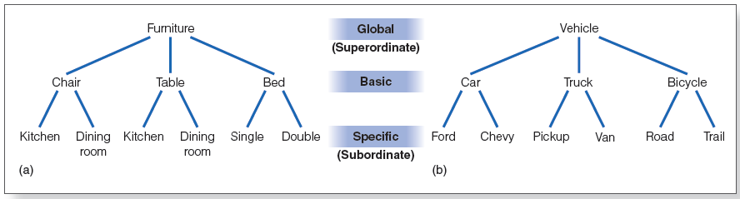
Hierarchical Organization (2 of 2)
Notes:
Figure 9.8 Levels of categories for (a) furniture and (b) vehicle. Rosch provided evidence for the idea that the basic level is “psychologically privileged.”

Slide 21
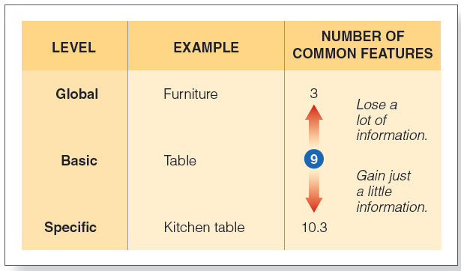
Evidence That Basic Level Is Special (1 of 2)
Going above basic level → large loss of information
Going below basic level → little gain of information
Notes:
Figure 9.9 Category levels, examples of each level, and average number of common features listed by participants in Rosch et al.’s (1976) experiment.

Slide 22
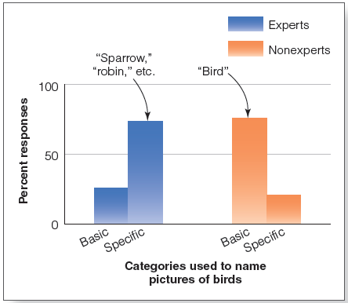
Evidence That Basic Level Is Special (2 of 2)
Notes:
Figure 9.11 Results of Tanaka and Taylor’s (1991) “expert” experiment. Experts (left pair of bars) used more specific categories to name birds, whereas nonexperts (right pair of bars) used more basic categories.

Slide 23
Semantic Networks (1 of 9)
Concepts are arranged in networks that represent the way concepts are organized in the mind
Collins and Quillian (1969)
  Node = category/concept
  Concepts are linked
  Model for how concepts and properties are associated in the mind

Slide 24
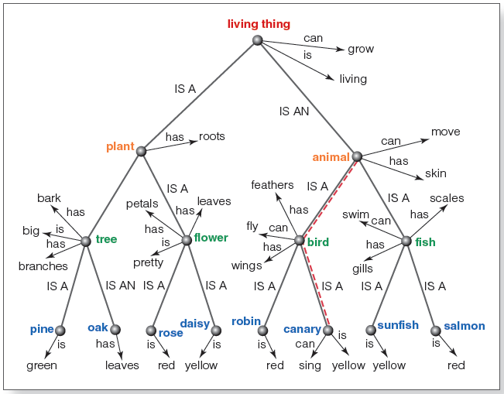
Semantic Networks (2 of 9)
Notes:
Figure 9.12 Collins and Quillian’s (1969) semantic network. Specific concepts are indicated in color. Properties of concepts are indicated at the nodes for each concept. Additional properties of a concept can be determined by moving up the network, along the lines connecting the concepts. For example, moving from “canary” up to “bird” indicates that canaries have feathers and wings and can fly. The dashed lines indicate the distance in the network from canary to bird and from bird to animal.

Slide 25
Semantic Networks (3 of 9)
Cognitive economy: shared properties are only stored at higher-level nodes
Exceptions are stored at lower nodes

Slide 26
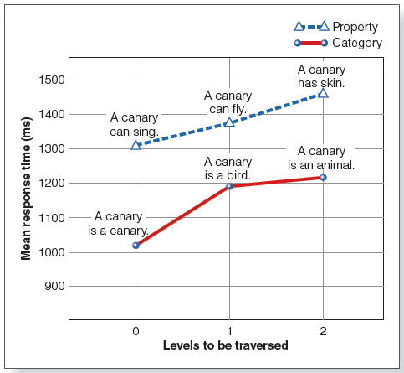
Semantic Networks (4 of 9)
Notes:
Figure 9.13 Results of Collins and Quillian’s (1969) experiment that measured reaction times to statements that involved traversing different distances in the network. Greater distances are associated with longer reaction times, when verifying statements both about properties of canaries (top) and about categories of which the canary is a member (bottom).

Slide 27
Semantic Networks (5 of 9)
Spreading activation
  Activation is the arousal level of a node.
  When a node is activated, activity spreads out along all connected links.
  Concepts that receive activation are primed and more easily accessed from memory.

Slide 28
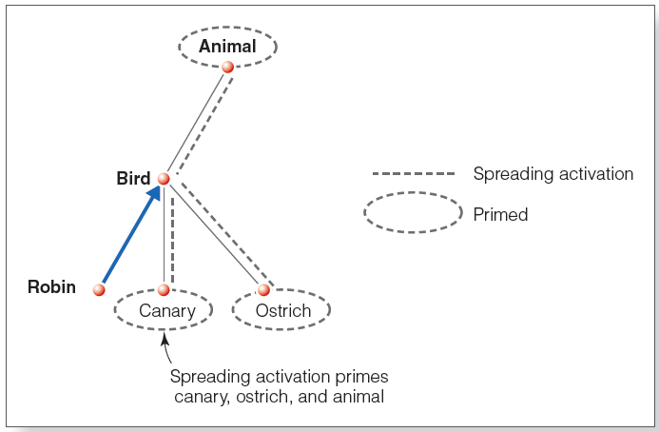
Semantic Networks (6 of 9)
Notes:
Figure 9.14 How activation can spread through a network as a person searches from “robin” to “bird” (blue arrow). The dashed lines indicate activation that is spreading from the activated bird node. Circled concepts, which have become primed, are easier to retrieve from memory because of the spreading activation

Slide 29
Semantic Networks (7 of 9)
Lexical decision task
  Participants read stimuli and are asked to say as quickly as possible whether the item is a word or not.

Slide 30
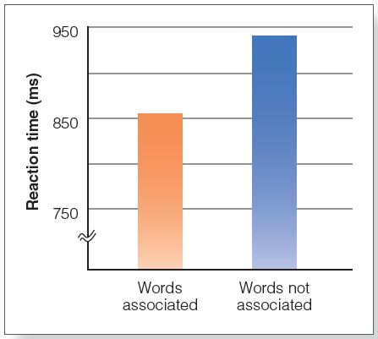
Semantic Networks (8 of 9)
Meyer and Schvaneveldt (1971)
  “Yes” if both strings are words; “no” if not
  Reaction time was faster for closely associated pairs
    Spreading activation
Notes:
Figure 9.15 Results of Meyer and Schvaneveldt’s (1971) experiment. Participants responded faster for words that were more closely associated (left bar).

Slide 31
Semantic Networks (9 of 9)
Criticism of the Collins and Quillian Model
  Cannot explain the typicality effects
  Cognitive economy?
  Some sentence-verification results are problematic for the model

Slide 32
The Connectionist Approach (1 of 7)
Creating computer models for representing cognitive processes
Parallel distributed processing
Knowledge represented in the distributed activity of many units
Weights determine at each connection how strongly an incoming signal will activate next unit

Slide 33
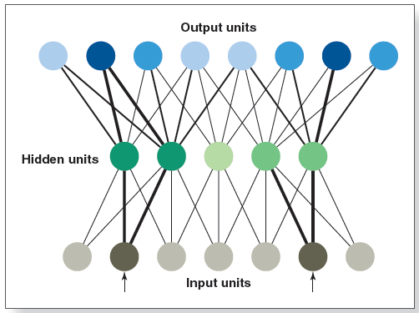
The Connectionist Approach (2 of 7)
Notes:
Figure 9.17 A parallel distributed processing (PDP) network showing input units, hidden units, and output units. Incoming stimuli, indicated by the arrows, activate the input units, and signals travel through the network, activating the hidden and output units. Activity of units is indicated by shading, with darker shading and heavier connector lines indicating more activity. The patterns of activity that occur in the hidden and output units are determined both by the initial activity of the input units and by the connection weights that determine how strongly a unit will be activated by incoming activity. Connection weights are not shown in this figure.

Slide 34
The Connectionist Approach (3 of 7)
“Units” in parallel distributed processing network
  Input units: activated by stimulation from the environment
  Hidden units: receive input from input units
  Output units: receive input from hidden units

Slide 35
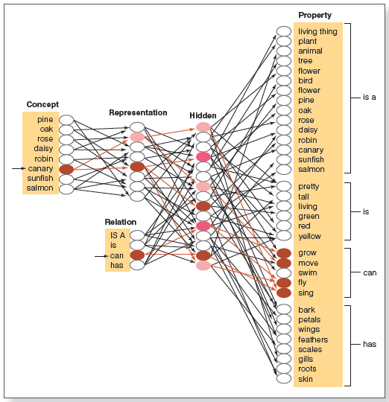
Notes:
Figure 9.18 A connectionist network. Activation of an item unit (“canary”) and a relation unit (can) causes activity to travel through the network that eventually results in activation of the property units grow, move, fly, and sing, associated with “canary can.” Shading indicates the activity of the units, with darker shading indicating more activity. Note that only a few of the units and connections that would be activated by “canary” and can are shown as being activated. In the actual network, many more units and connections would be activated.

Slide 36
The Connectionist Approach (5 of 7)
How learning occurs
  Network responds to stimulus
  Provided with correct response
  Modifies responding to match correct response

Slide 37
The Connectionist Approach (6 of 7)
Error signal
  Difference between actual activity of each output unit and the correct activity
Back propagation: error signal transmitted back through the circuit
Indicates how weights should be changed to allow output signal to match the correct signal
Process repeats until the error signal is zero

Slide 38
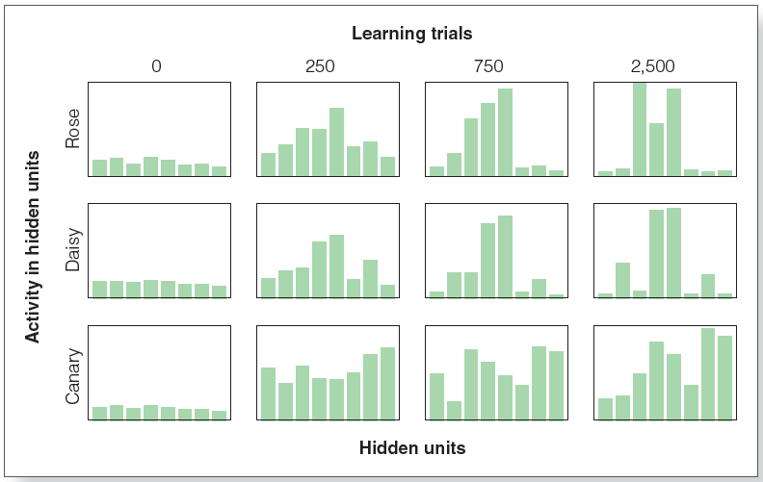
The Connectionist Approach (7 of 7)
Notes:
(Source: AdapFigure 9.20 Learning in a connectionist network. Bars represent activity in the eight representation units. Notice how the pattern of activation changes as learning progresses.
ted from J. L. McClelland & T. T. Rogers, 2003)

Slide 39
Support for Connectionism
Graceful degradation: performance disruption occurs gradually as parts of the system are damaged
  Network operation is not totally disrupted by damage
Explains generalization of learning
  Training system to recognize properties of one concept provides information about related concepts
Similar to human learning process

Slide 40
Sensory-Functional Hypothesis (1 of 2)
Different brain areas may be specialized to process information about different categories
  Double dissociation for categories “living things” and “nonliving things” (artifacts)
  Category-specific memory impairment
Sensory-functional hypothesis:
  living things → sensory properties
  artifacts → functions

Slide 41
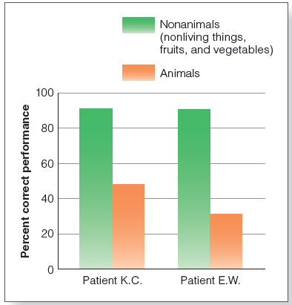
Sensory-Functional Hypothesis (2 of 2)
Notes:
Figure 9.21 Performance on a naming task for patients K.C. and E.W., both of whom had category-specific memory impairment. They were able to correctly name pictures of nonliving things (such as car and table) and fruits and vegetables (such as tomato and pear) but performed poorly when asked to name pictures of animals.

Slide 42
The Multiple-Factor Approach
Distributed representation: how concepts are divided within a category
  Animals → motion and color
  Artifacts → actions (using, interacting)
Crowding: when different concepts within a category share many properties
  For example, “animals” all share “eyes,” “legs,” and “the ability to move”

Slide 43
The Embodied Approach (1 of 2)
Knowledge of concepts is based on reactivation of sensory and motor processes that occur when we interact with the object.
Mirror neurons: fire when we do a task or we observe another doing that same task
Semantic somatotopy: correspondence between words related to specific body parts and the location of brain activation

Slide 44
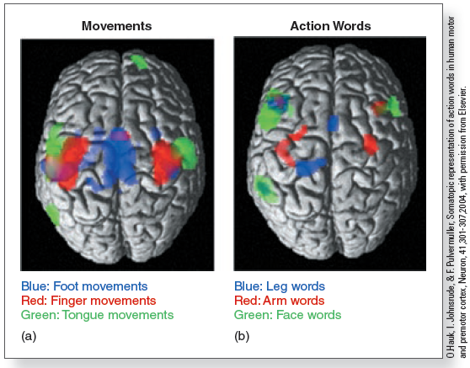
The Embodied Approach (2 of 2)
Figure 9.26 Hauk et al. (2004) results. Colored areas indicate the areas of the brain activated by (a) foot, finger, and tongue movements; (b) leg, arm, and face words.
Notes:
(Source: Hauk et al., 2004)

